Slide 1
Community of Practice
Discussion 5: Five Steps to the Golden Ticket

Slide 2
Discussion: Golden Ticket Week 1
What happens with first 20?
What happens with the first 20?
Why March 11th is the deadline?
What does NMPBS have to do with this?
What does this have to do with find the key pieces for digital equity?
Notes:
Inquiries or questions are more significant right now than having the answers.
Activity: Choose a goal -related to your ideas for improving. Determine Who do you most want to communicate with regarding this?
Make video about this- it may include:
Connections in the home for parents, students and teachers to communicate
what kind of teaching and learning these can support
feedback about opportunities to learn from parents, teachers and students, and the larger community
Discussion Opportunity
Clarifying your goal
Who you want to learn with and why?
What tools might you use?
Next steps to take-
Pod connections
Date and time?
Weekly Practice
Meet with your Pod: and discuss your observations, how you have been engaging and what your key takeaways are.
Make a note in your journal: what needs to improve related to speed of the technology in your home?
What difference will this make for your learning?
Other ideas you want to share

Slide 3
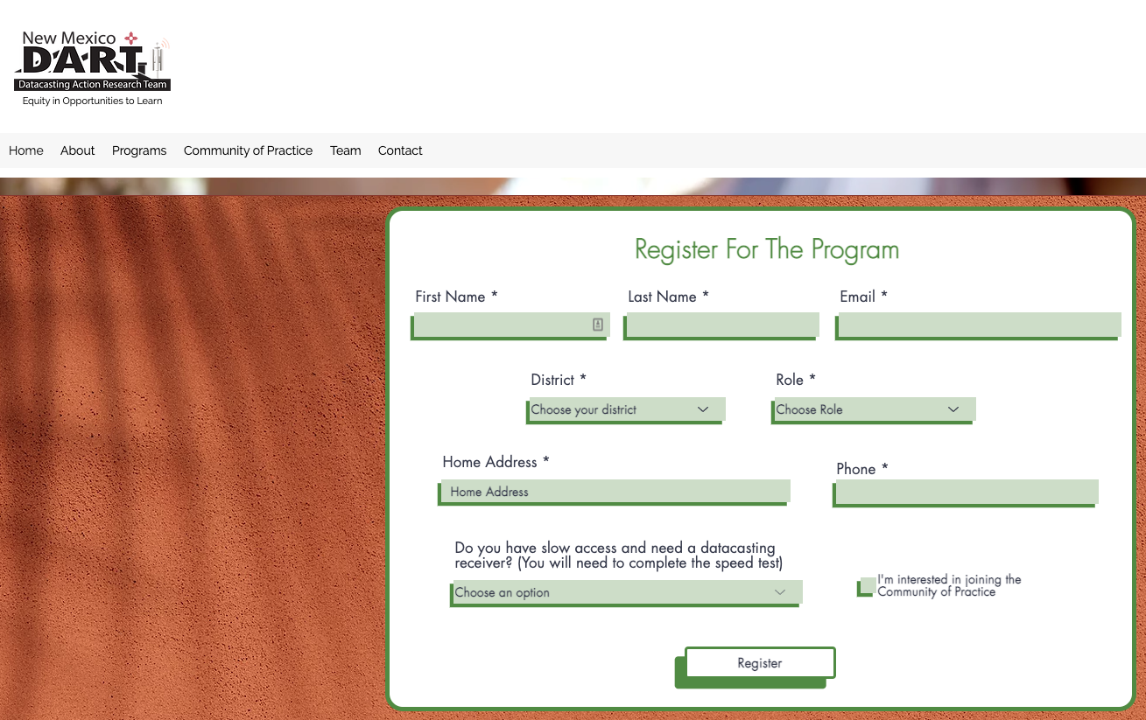
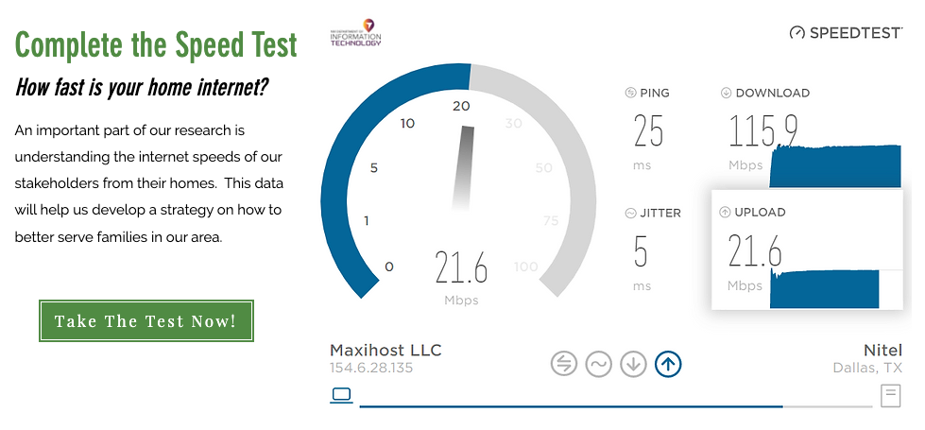
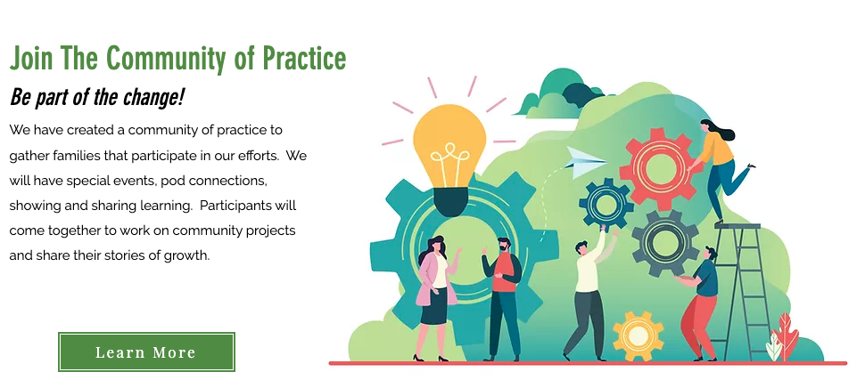

Slide 4
What is else is possible for you this week?
New Mexico Public Broadcasting System will be filming 10 students learning
at home with the use of your data casting receiver; and ALSO participating with 10
teachers who are sharing their creative lessons remotely
The lesson that is on the datacasting receiver will be one that comes
from teachers using their Google Classroom or Canvas learning
management system.
Lights! Camera! Action! NMPBS is seeking homes to visit in order to
capture learning together at home.
Notes:
Putting together a jig saw puzzle- what is your typical approach? What is a good place to start?

Slide 5
How to earn your DART Golden Ticket
Go to: https://www.newmexicodart.com/
Complete all fields, click “Register”, then take the speed test (5-10 minutes)
Check the box: Community of Practice

Slide 6
How to earn your DART Golden Ticket
2. You will get an email with a link to your copy of the survey (takes 5-10 minutes)
Complete the survey!

Slide 7
How to earn your DART Golden Ticket
3. Sign your family up for Family Learning (takes 5-10 minutes)
Click the Register Now button!
https://www.newmexicodart.com/

Slide 8
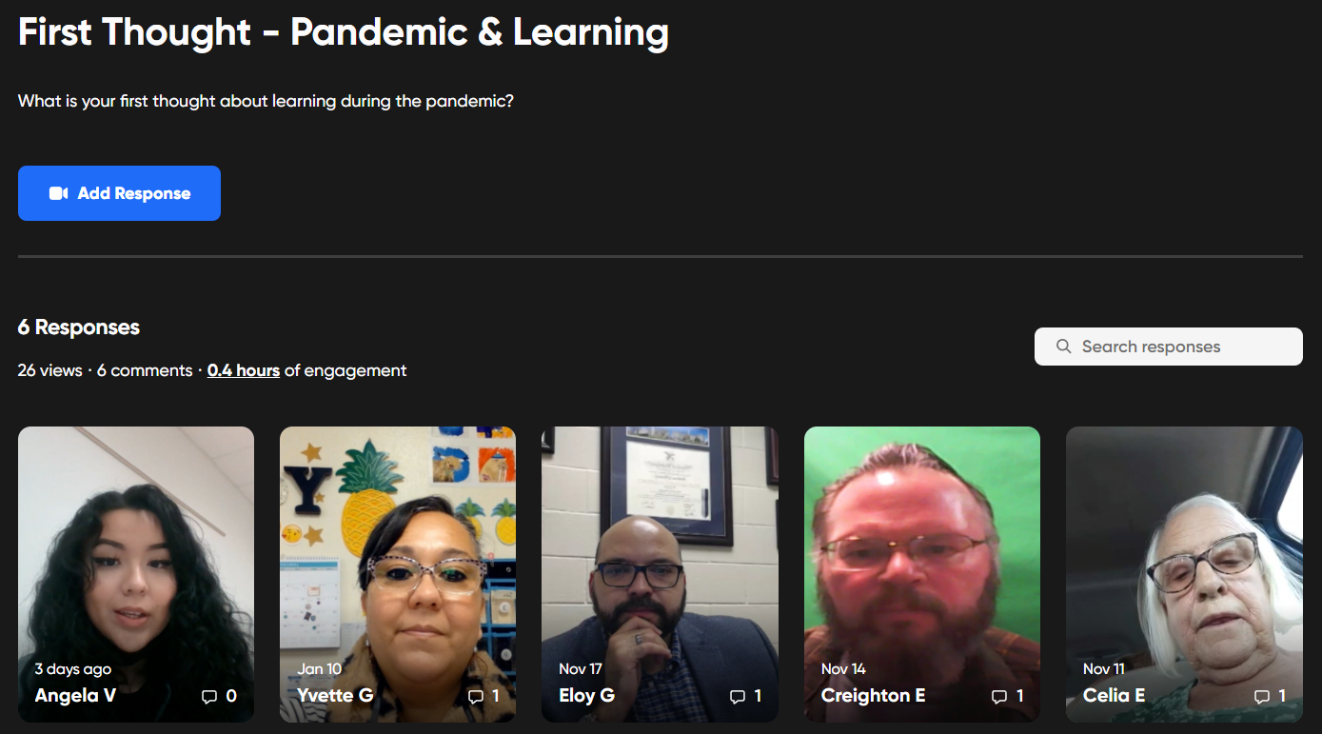
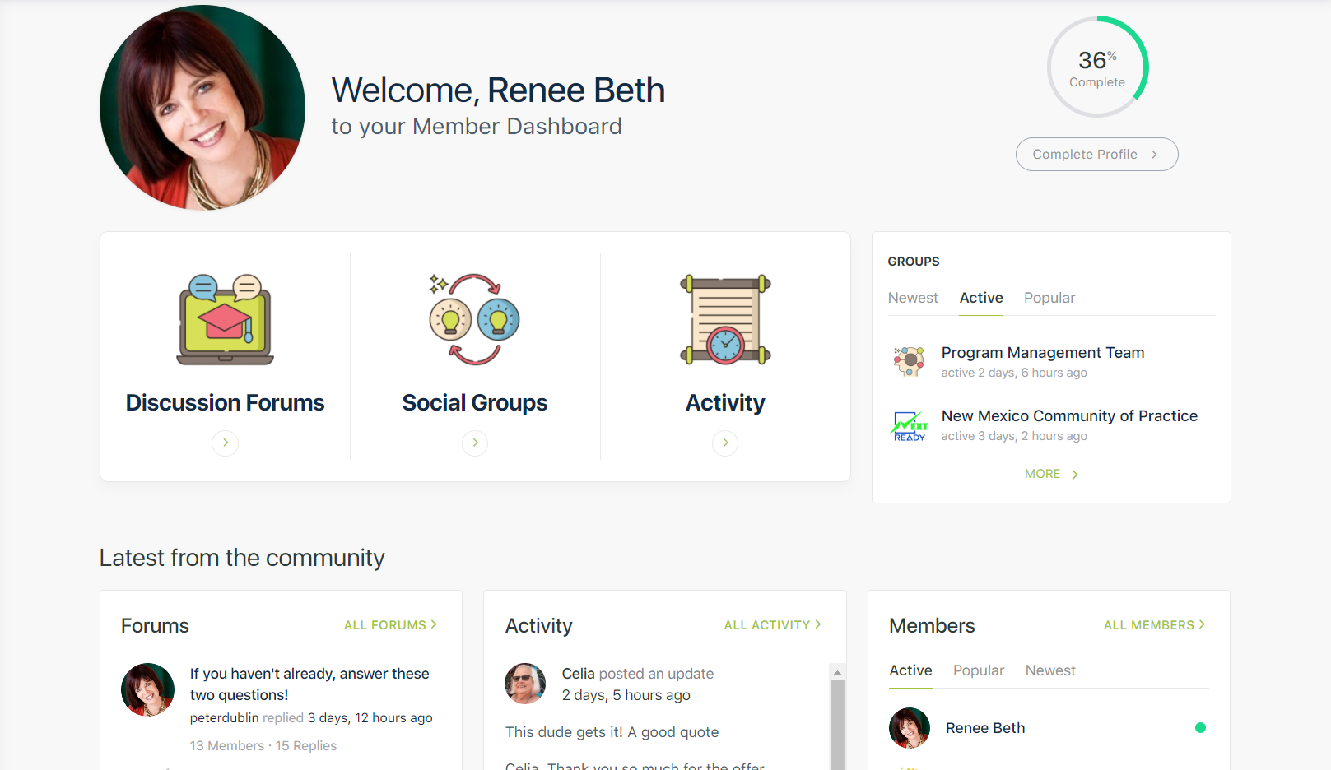
Learning together in Community
4. Join the Community of Practice : Go to: https://www.newmexicodart.com/ and click the box Community of Practice on the Registration page
A Community of Practice provides a shared context for people to communicate and share information.
Asking and listening for the 2 intro questions in the lobby:
What stories of learning happened during the pandemic?
What are a few things you want to improve?
Notes:
How the CoP supports the evidence- here- where the conversation happens - Picture of Dashboard,and the Lobby- that shows the questions

Slide 9
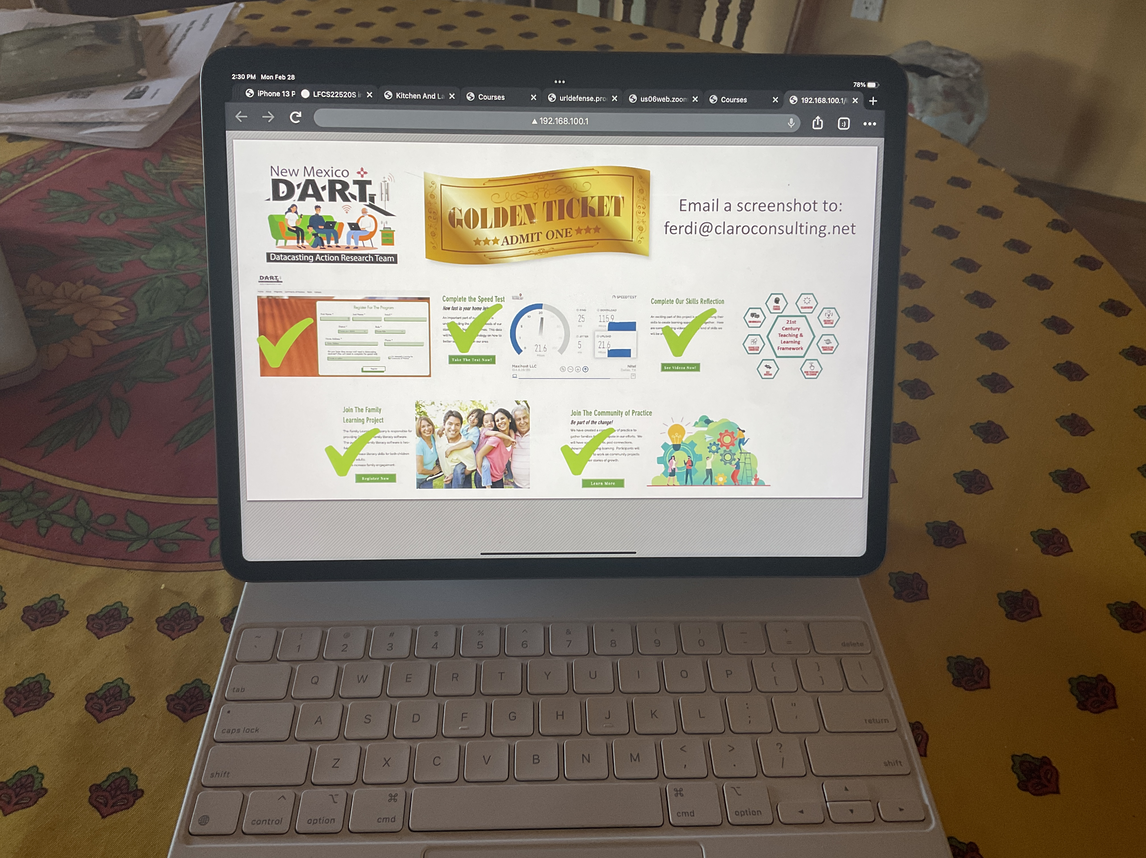
How to earn your DART Golden Ticket
5. Go to “Digital Champions” in the Library on your datacasting receiver and take a screenshot
Email your screenshot to ferdi@claroconsulting.net
All entries must be received by Friday March 11

Slide 10
What are the benefits of getting the Golden Ticket
You become a key player in the DART Pilot Program
You have the keys to the 21st Century Teaching and Learning Skillset
Your family has a fun Family Learning software with over 9,000 activities
You will have the code to engage with new a Community for access and opportunity
If you are one of the first 20 people ( first 10 student/family and first 10 teachers) – you will receive $100*
]*There is more opportunity to share ideas and earn a $1500 stipend- ask and you will discover
how to submit a “recipe” for the DART cook book
Notes:
Each person shares: what is not working and how they feel about it.
Everyone in the circle shares:
Next round: what is a worse possible outcome?
What would be best possible outcome to solve the problem?

Slide 11
The Puzzle We are Trying to Solve
Your piece is important- your survey and speed test matter
Your piece helps to solve the challenge: lets get digital equity for everyone
Join in the Community of Practice:
Working together with others creates a whole new perspective
The Whole Puzzle is greater than the sum of all the pieces
Together we can put together the pieces in ways that shows what we
might be missing
Notes:
Putting together a jig saw puzzle- what is your typical approach? What is a good place to start?

Slide 12
Questions Hold the Power
We don’t know what we don’t know
Questions open us to finding the answers
What question do you have?
Asking it will help all of us discover ways of looking and seeing possibilities.
Notes:
Inquiries or questions are more significant right now than having the answers.
Discussion: what’s your favorite question of the day?
Activity: Choose a goal -related to your ideas for improving. Determine Who do you most want to communicate with regarding this?
Make video about this- it may include:
Connections in the home for parents, students and teachers to communicate
what kind of teaching and learning these can support
feedback about opportunities to learn from parents, teachers and students, and the larger community
Discussion Opportunity
Clarifying your goal
Who you want to learn with and why?
What tools might you use?
Next steps to take-
Pod connections
Date and time?
Weekly Practice
Meet with your Pod: and discuss your observations, how you have been engaging and what your key takeaways are.
Make a note in your journal: what needs to improve related to speed of the technology in your home?
What difference will this make for your learning?
Other ideas you want to share

Slide 13
Activity
Activity: Do the 5 steps-to Access the Golden Ticket (be one of the first 20 to win the $ before March 11th)
Make video about this. It may include how you did this: were you on your own-or did you have a partner?
What is exciting to you about doing the 5 steps- were you on your own-or did you have a partner?
Imagine you and your teacher – sharing the learning-with the help of your datacasting receiver
Maybe PBS will be knocking on your door: what fun!
Spend 30 minutes with another person from your family in the Family Learning Software
Connect in the Community of Practice:
Comment on what you think about the speed test; the skills survey and the Family Learning software
Notes:
Clarifying your goal
Who you want to learn with and why?
Frustration with adapting to new tools
Impatience with the process
Needing answers and where to go to find them
How to best use the CoP to get what you need
Getting the support when you show up and participate
What tools might you use?
Next steps to take-
Pod connections
Date and time?
Weekly Practice
Meet with your Pod: and discuss your observations, how you have been engaging and what your key takeaways are.
Make a note in your journal: what needs to improve related to speed of the technology in your home?
What difference will this make for your learning?
Other ideas you want to share

Slide 14
What’s Next?
Connect with others in the Community of Practice
Discuss your observations
Share a video about your how you discovered the Golden Ticket.
Connect with someone you know you could ask for guidance?
Ask for the support you need to help with your pursuit?
Mark your calendars:
Friday is Reflection and Review Day and DUE Date to be one of the top10
Student/Family and top10 teachers….

