Slide 2
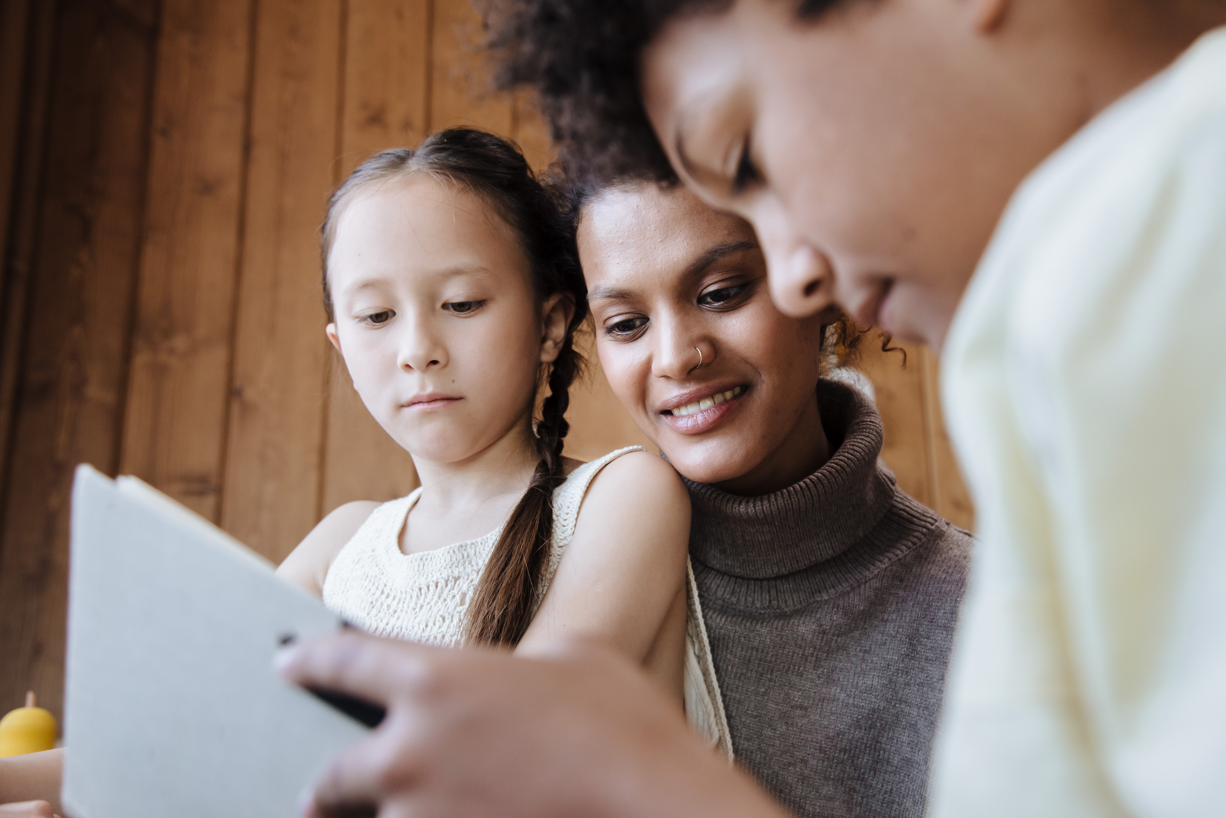
Community of Practice
Lesson 4: Trusting the Seeds– Improving Learning at Home

Slide 3
Family Learning Ideas
What can you do with your Datacasting/Hot spot?
Technology Learning Moment: Family Learning Software
Notes:
Alyssa-Youmay be abletopick up graphics here
Renee Beth
You can access Elementary Family Literacy by going to:
flclogin.com/elem
Your username: renee beth
Password: no password
If you want to add others (colleagues or your partner’s children, for example) you click the Settings (gear) icon and then the Family Members icon. Here is where you can also change your username (and add a password, if so inclined) and switch from one product to another. Make sure, as you explore, to click the Parent Advice icon at various places (all menus and activities) in the two products for young children.
Peter
—————
Peter Dublin, Ed.D., President
2

Slide 4
Family Learning Ideas
Family Learning Literacy Software:
Modules: Elementary, Middle School, High School, Adult Literacy
Languages: English & Spanish
Literacy Categories:
Phonics
Reading
Vocabulary
Writing
Levels: 1 - 16
Notes:
Alyssa-Youmay be abletopick up graphics here
Renee Beth
You can access Elementary Family Literacy by going to:
flclogin.com/elem
Your username: renee beth
Password: no password
If you want to add others (colleagues or your partner’s children, for example) you click the Settings (gear) icon and then the Family Members icon. Here is where you can also change your username (and add a password, if so inclined) and switch from one product to another. Make sure, as you explore, to click the Parent Advice icon at various places (all menus and activities) in the two products for young children.
Peter
—————
Peter Dublin, Ed.D., President
2

Slide 5
Playing to Discover Learning Moments
Learning Moments: Discovering Something New:
Before you use the software:
What will improving their reading and writing skills do for your children?
When will the Family play with this software?
Who will learn together?
Is there anything you want to learn about reading or writing?

Slide 6
Playing to Discover Learning Moments
After you use the software:
What did your children learn?
Who did they share their learning with?
What was the most fun?
What was the most challenging?
How did you fit it in your daily or weekly schedule?
What did you learn?

Slide 7
Free Family Learning Software
Go to: www.familylearningcompany.com
Select: Enter Code button
CODE: nmdatacast
Notes:
Alyssa-Youmay be abletopick up graphics here
Renee Beth
You can access Elementary Family Literacy by going to:
flclogin.com/elem
Your username: renee beth
Password: no password
If you want to add others (colleagues or your partner’s children, for example) you click the Settings (gear) icon and then the Family Members icon. Here is where you can also change your username (and add a password, if so inclined) and switch from one product to another. Make sure, as you explore, to click the Parent Advice icon at various places (all menus and activities) in the two products for young children.
Peter
—————
Peter Dublin, Ed.D., President
2

Slide 8
Family Learning Activity
Activity: Plan 30 minutes tomorrow to explore the Family Learning Software
Team up with a family member and take turns exploring and learning together
Set a goal: pick a level and subject and see how many green stars you can get!
Make a video of your experience in Flip Grid
Place it in the Community of Practice
Make a note in your journal about your experience
Make another date to play with the software with a family member
Notes:
Take what you have learned and share it with someone who wants to learn what youhave discovered-Make a video of it

Slide 9
What’s Next?
Connect with others in the Community of Practice
Discuss your observations
Share a video of how you are using this skill in your life
Connect with someone you know who has more experience with this skill, a guide you could ask for guidance?
Ask for the support you need to help with your improvement/theme or goal?
Mark your calendars:
Wednesday is Discussion Day-Noon MT
Friday is Reflection and Review Day
Sunday, March 6th Open House: Register in Learning Together Events

