Slide 1
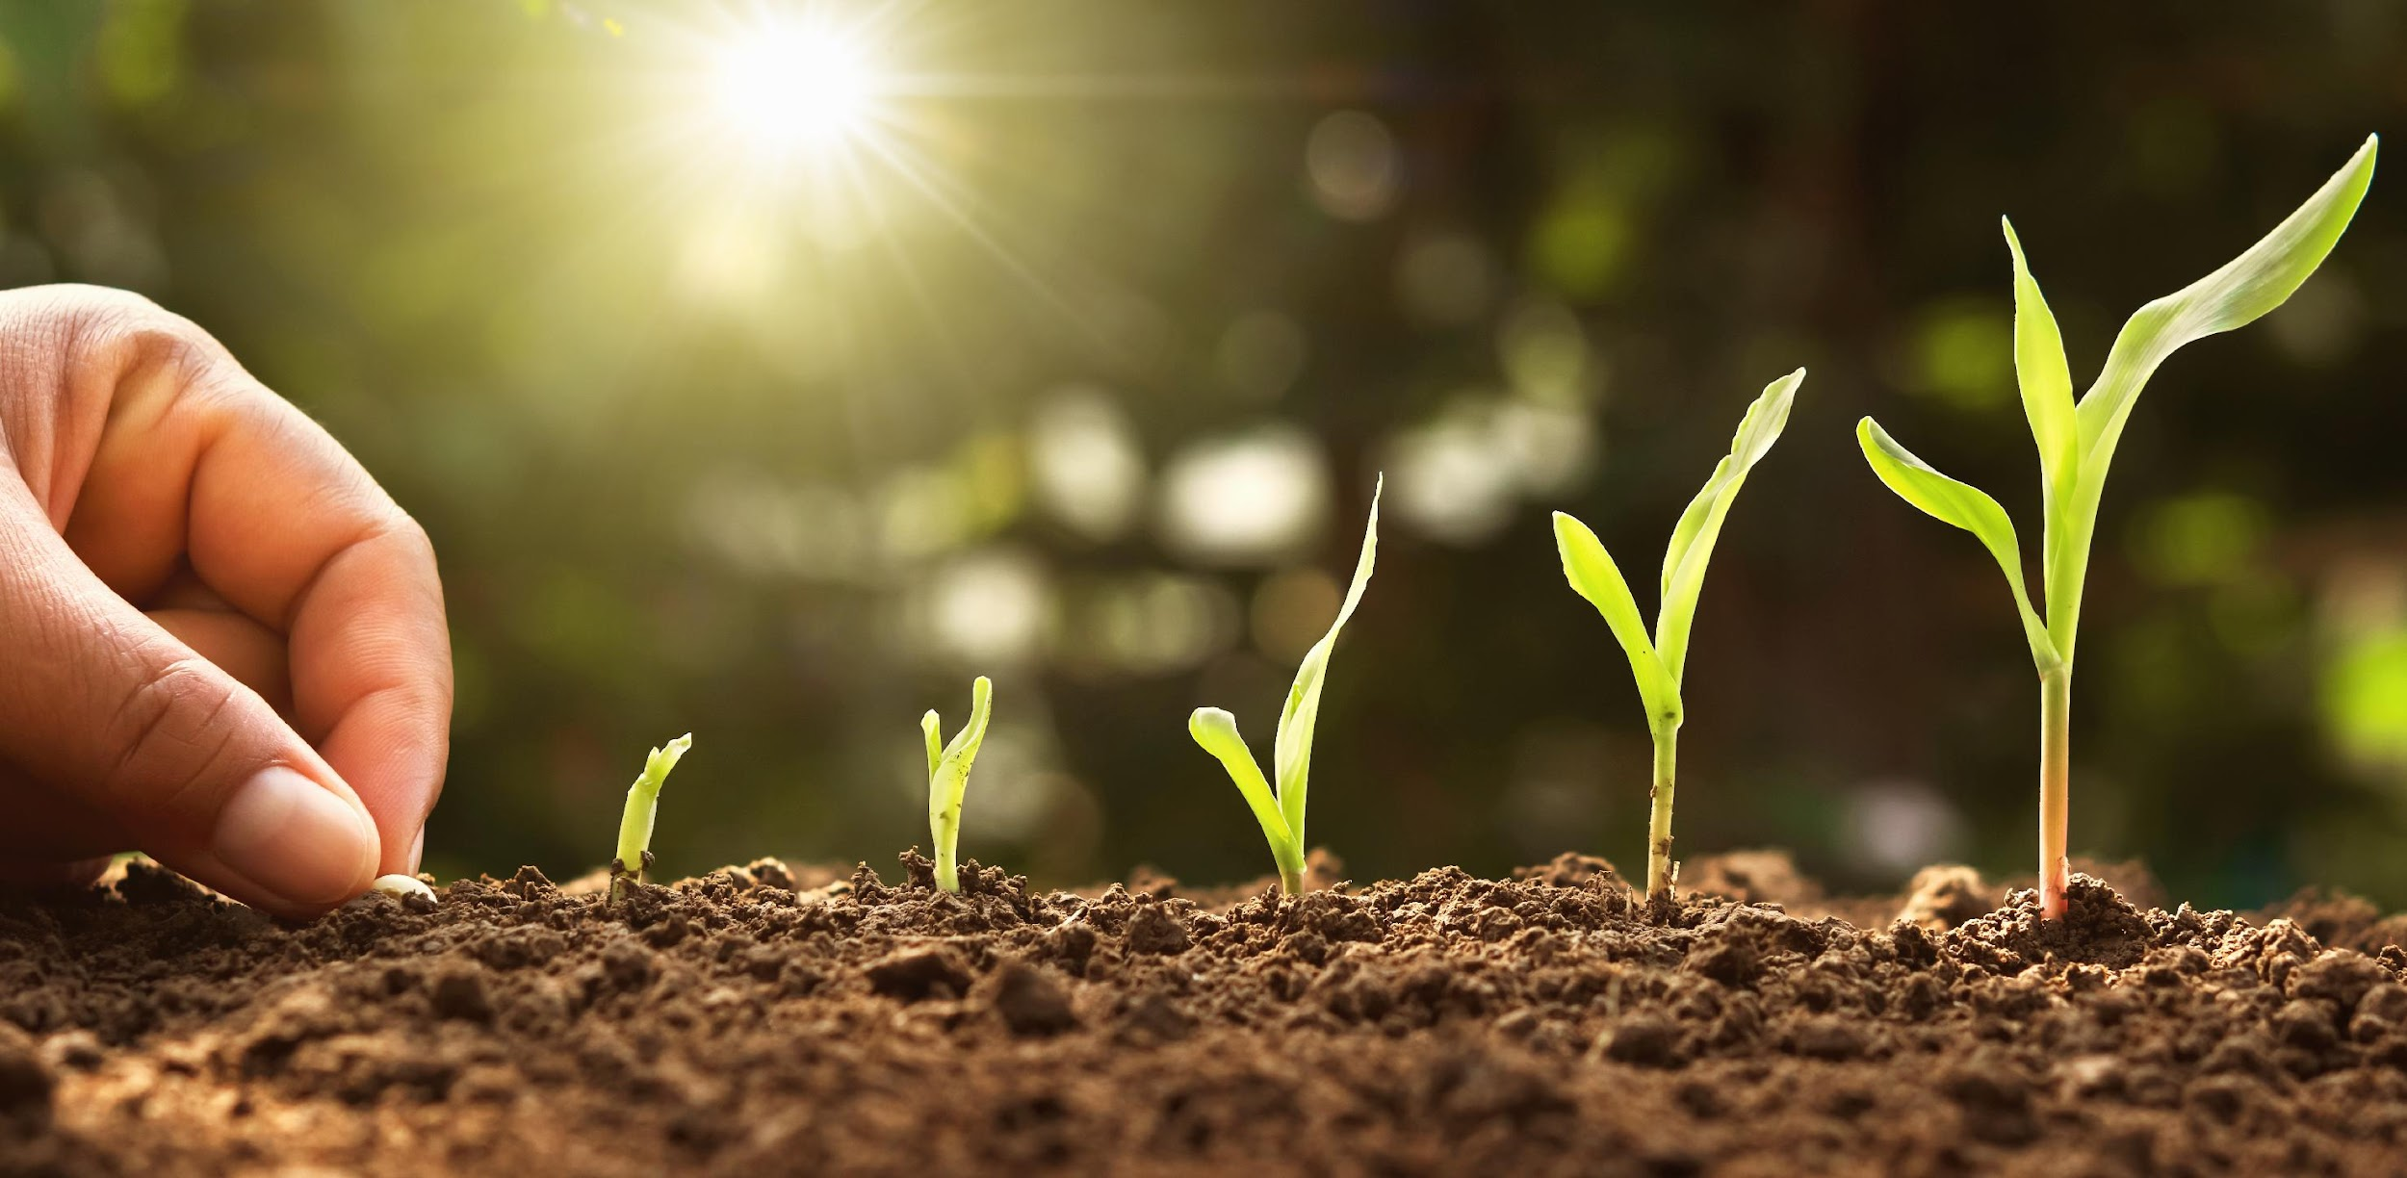
Community of Practice
Lesson 3 Discussion: Skills to Trusting the Seeds of Discovery

Slide 2
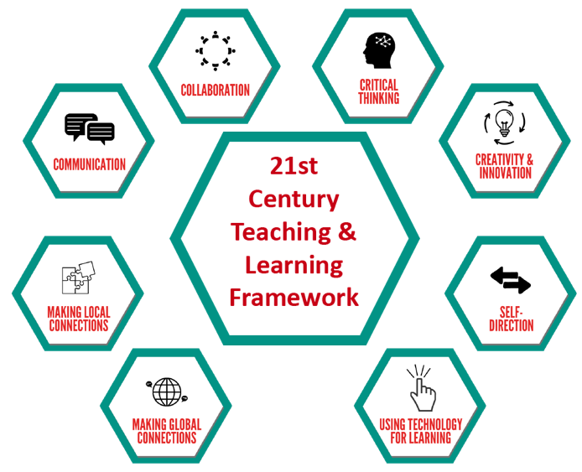
Communication
Critical Thinking
Creativity and Innovation
Collaboration
Local Connections
Global Connections
Learning with Technology
Discover HOW these skills can help you
Notes:
Why do these kills Matter? Because they can help you in many ways.

Slide 3
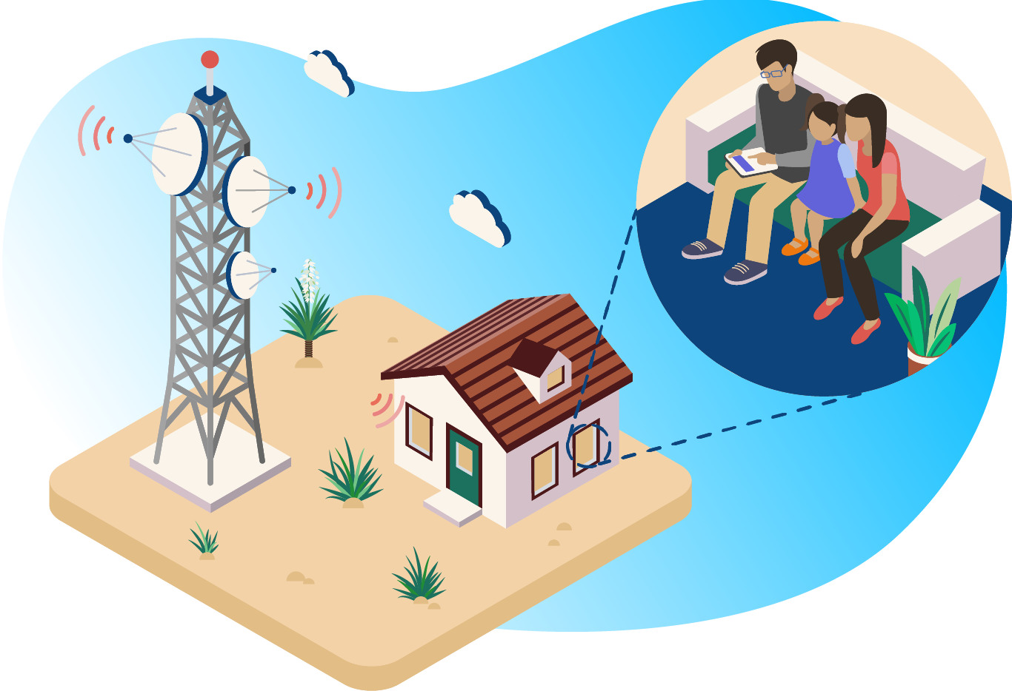
Learning is Happening Every Day
No matter what we are doing, we can use different skills to learn together and use technology as a resource.
Notes:
ORIGINAL: Learning is happening everyday no matter what we are doing-and these skills are relevant to observing our learning experience with technology as a resource.

Slide 4
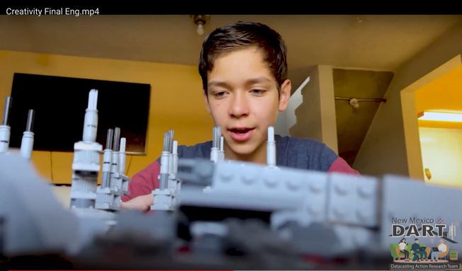
Using the 8 skills: Moving to Mexico
Overview Video
 | Creativity example
Video credits: Sarvelio Carreon and family (the “image factory”)
Notes:
Survelio Carreon and family

Slide 5
Discussion Opportunity
What do we want to do with our skills? (what is your recipe for ?)
What skill(s) do you have to share?
What ways will you use your skills TODAY?
Are there any skills you are working on – or want to improve?
Who or what helps you build your skills?
Which skills do we need to be successful in this project? Which of the above possibly has a “right” answer?
Notes:
Original
What tools are you using that can best support you in attaining these skills?
These skills are what the workplace employers are looking for in their future employees- why do you think this is so?
Which are your top 3 skills you want to get better at? How might you accomplish this within the next 2 weeks?
What do you need to help you be successful?
What advice do you have?

Slide 6
Microseasons Example - An opportunity for discovery
Connecting with the world around us
Sharing about ourselves
Building our skills
Creating an online community

Slide 7
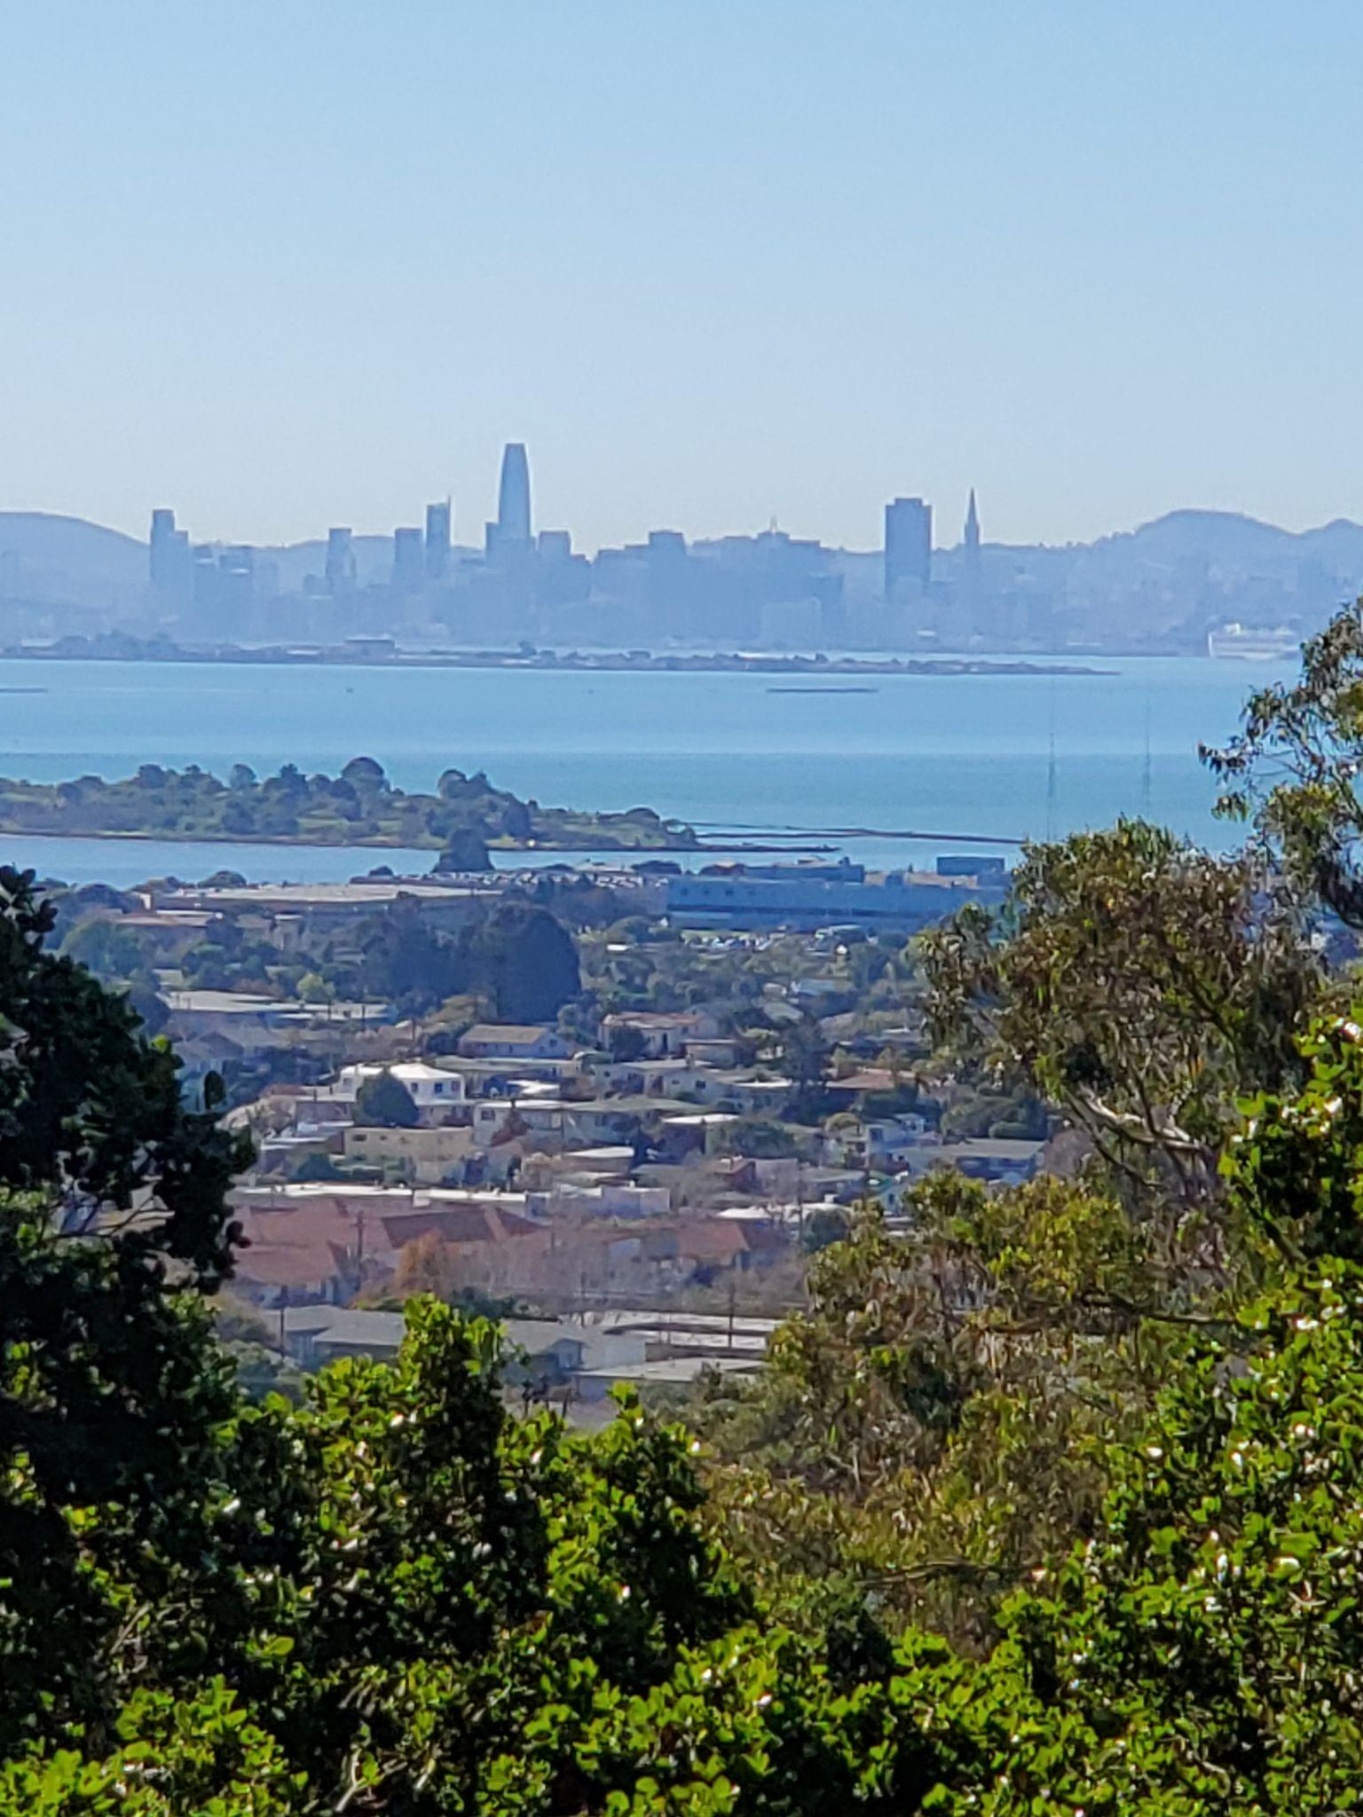
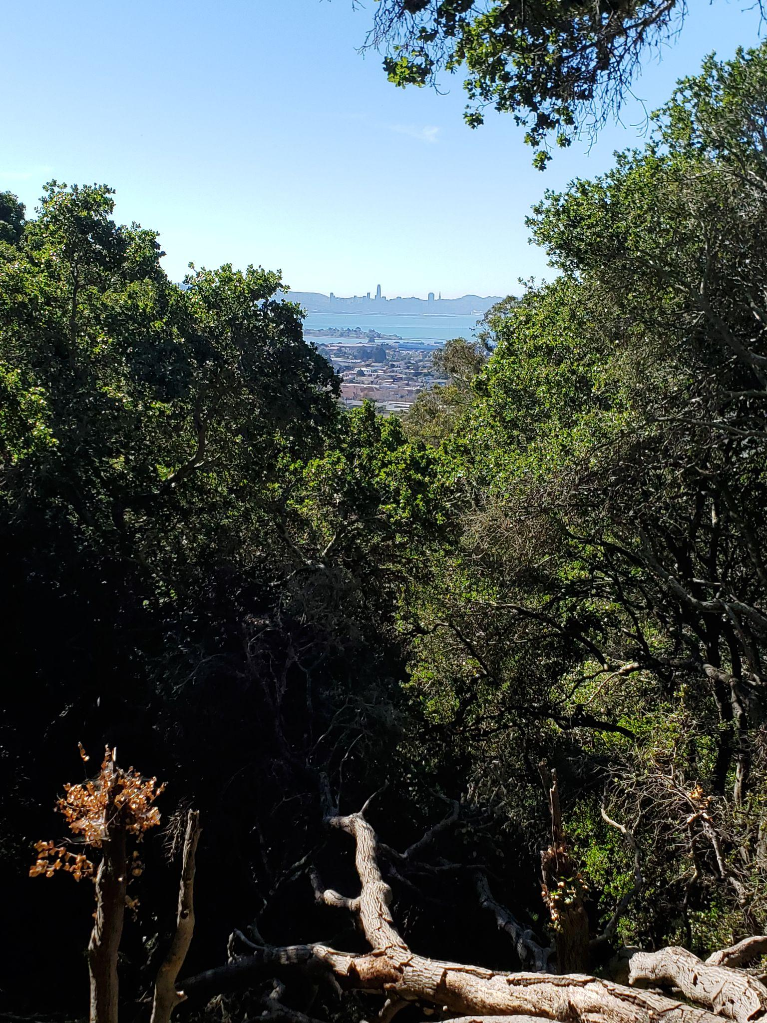
In our world famous city
among the most beautiful
boots are
put away
and rain is gone
but hopefully not for good
JLR
Notes:
This is the same photo,one just zoomed way in. I tried to work in the boots concept a little.

Slide 8
What skills did I use?
For this project I used
creativity and innovation – tried a few ideas and refined one
local connections – what is unique about here
global connections – photo of world famous Golden Gate Bridge and reference to SF
communication – clarifying using a few words and pictures with layout
self-direction – decided to take time away from other projects to do this
critical thinking – using criteria to make decisions about which photo to use
Focus on Critical Thinking
Considered alternatives
Work on neighborhood houses, post-rainy season (but this will continue after grasses turn brown)
Delicious plum tree blossoms - perfect, only a short while (but less tied to my location)
Used criteria - What is unique about this place and time?
Made a decision using reasoning
Decided this one was more reflective of who and where I am.
JLR

Slide 9
Discussion Topics
What do we want to do with our skills? (what is your recipe for ?)
To improve your 2 things (or for your Cookbook recipe)
What skills do you see yourself exercising to make things better?
What skills will other people strengthen, if you are successful?
Who or what helps you build your skills?
How might your work help others learn or demonstrate their skills?
Which of the above possibly has a “right” answer?
Notes:
Original
What tools are you using that can best support you in attaining these skills?
These skills are what the workplace employers are looking for in their future employees- why do you think this is so?
Which are your top 3 skills you want to get better at? How might you accomplish this within the next 2 weeks?
What do you need to help you be successful?
What advice do you have?

Slide 10
What’s Next?
Meet with others
Discuss your observations
Pick one skill and create a video of how you are using this skill in your life
Who do you know that has more experience with this skill, a guide you could ask for guidance?
Microseasons Project: How it could support you with your improvement/theme or goal?
Actions and expressions:
Make a note in the Community of Practice and comment on what you see
Take a picture of you learning your skill And/Or make a video
Find the link in your email to share YOUR skills. (Subject: "Datacasting NM: Welcome / Bienvenidos)
Participate in the Review Session on Friday

