Slide 1
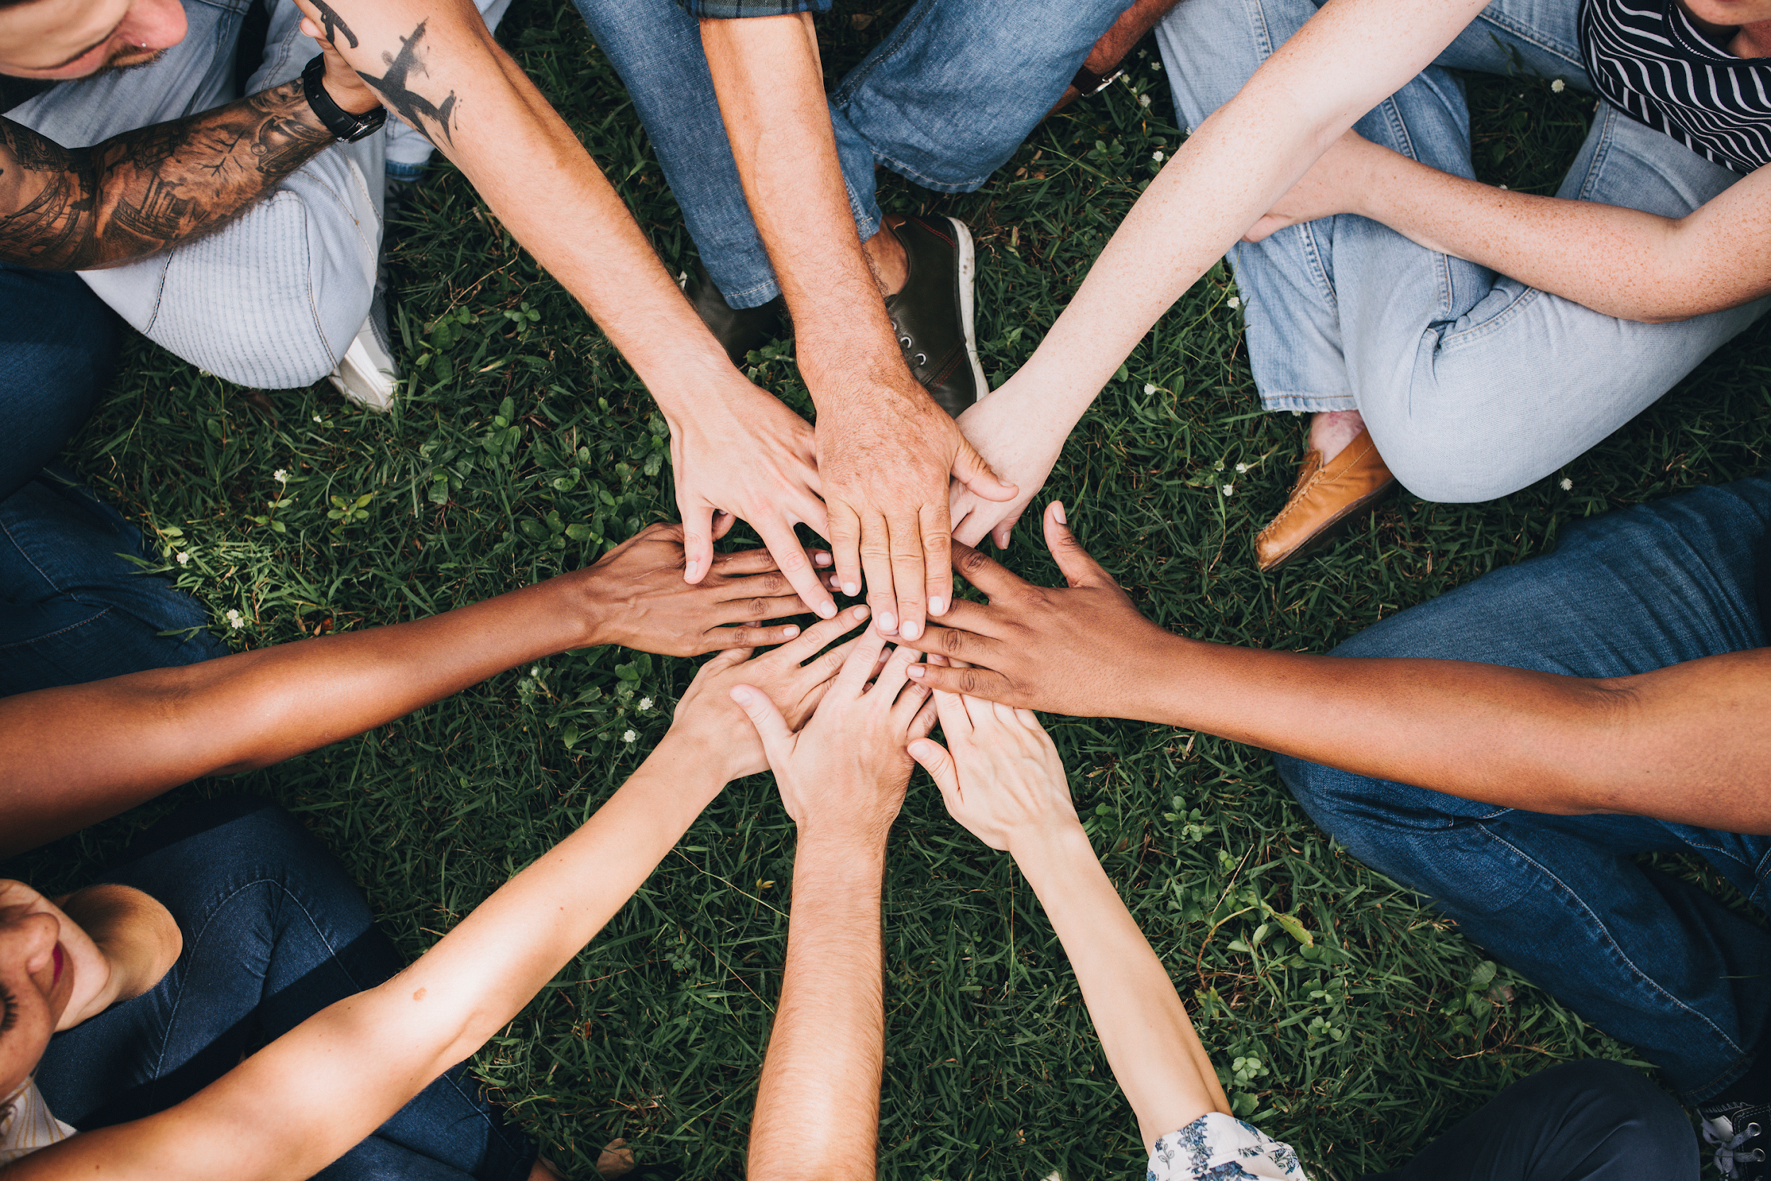
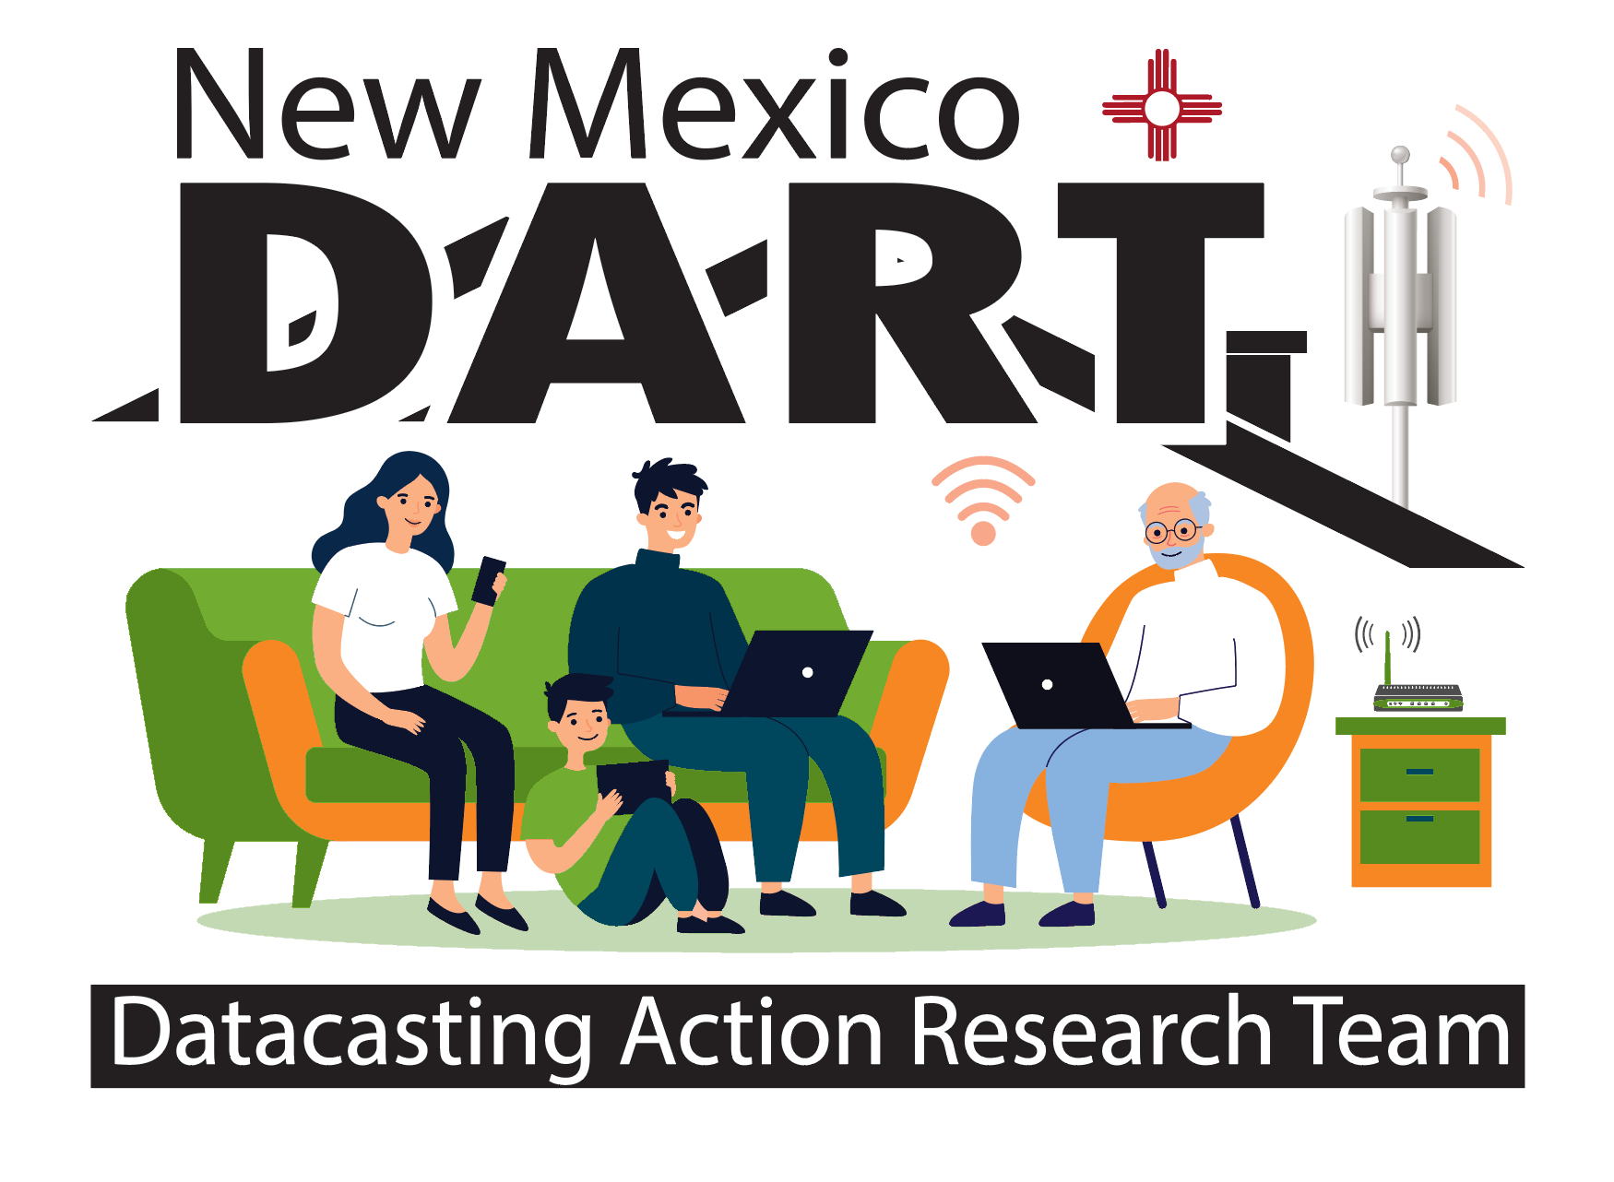
Community of Practice
Lesson 2 : SCOUT Learning
Connectivity Learning Recipes
Notes:
Welcome: We are on a mission! You have been invited to participate in this Pilot Project called DART: Datacasting Action Research Team. Together, we will discover possibilities for solving the problem of lack of connectivity. In cooperation with the New Mexico Public Education Department (NMPED), we are piloting datacasting as a method of improving learning in the home, especially for families whose internet access is not strong enough to support online learning. Under the terms of the Martinez/Yazzie Lawsuit, every family must have a computing device available for learning with a connection that lets learners stream a video, upload/download files and participate in online learning using the systems it provides.
To accomplish these goals, the Datacasting Pilot is seeking parents and teachers to join DART – Datacasting Action Research Teams – who together will produce a final product called the “Datacasting Family Cookbook: Recipes for Improving Learning @ Home”

Slide 2
Why a Cookbook?
Recipes: come from experience; they are shared because of good results; provide instructions for duplicating success- and they are easy to pass on
Notes:
The families who have the receivers will be engaged with their children, along with their teachers and facilitators, to give feedback and ideas for what works and what doesn’t along with new insights that have emerged from learning together with the datacasting receiver and its capacity to deliver communication for learning at home. These ideas, or best practices, will be gathered as recipes for the DART Cookbook, which will support how to best implement the strategies for over 42,000 homes in New Mexico who are currently not being served equitably with technology connectivity.

Slide 3
Cookbook Themes: Improving Learning at home
Theme 1: Improving Connections-How to:
match your connectivity with the communication options you have
nurture communication among parents, teachers, students
Theme 1.1: Improving Family Supports-How to:
identify and provide IT support required to meet family tech needs
identify and obtain available funding for family internet and device needs

Slide 4
Cookbook Themes: Improving Learning at home
Theme 2: Improving Learning @Home-How to:
time management strategies that meets family needs
space arrangements that support student learning @home
Theme 2.1: Improving Engagement-How to:
design learning activities that maximize benefits from home ”digital library” resources
meet the needs of all learners through Universal Design for Learning and Culturally Responsive Learning principles

Slide 5
Cookbook Themes: Improving Learning at home
Theme 2.2: Access to Digital Resources-How to:
curate and manage district resources to be made available on datacasting receivers
curate and manage community resources for families
Theme 2.3: Improving Literacy-How to:
begin learning together, at home, each day
connect with other families using the platform

Slide 6
Cookbook Themes: Improving Learning at home
Theme 2.4: Improving Academics-How to:
take full advantage of the “digital library” your datacasting receiver brings to your home
Rate and review “nominated best practices” by level and subject
Theme 2.5: Improving 21st Century Skills-How to:
develop and document mastery of key workplace readiness skills
build a portfolio of evidence for using these skills for your deliverable

Slide 7
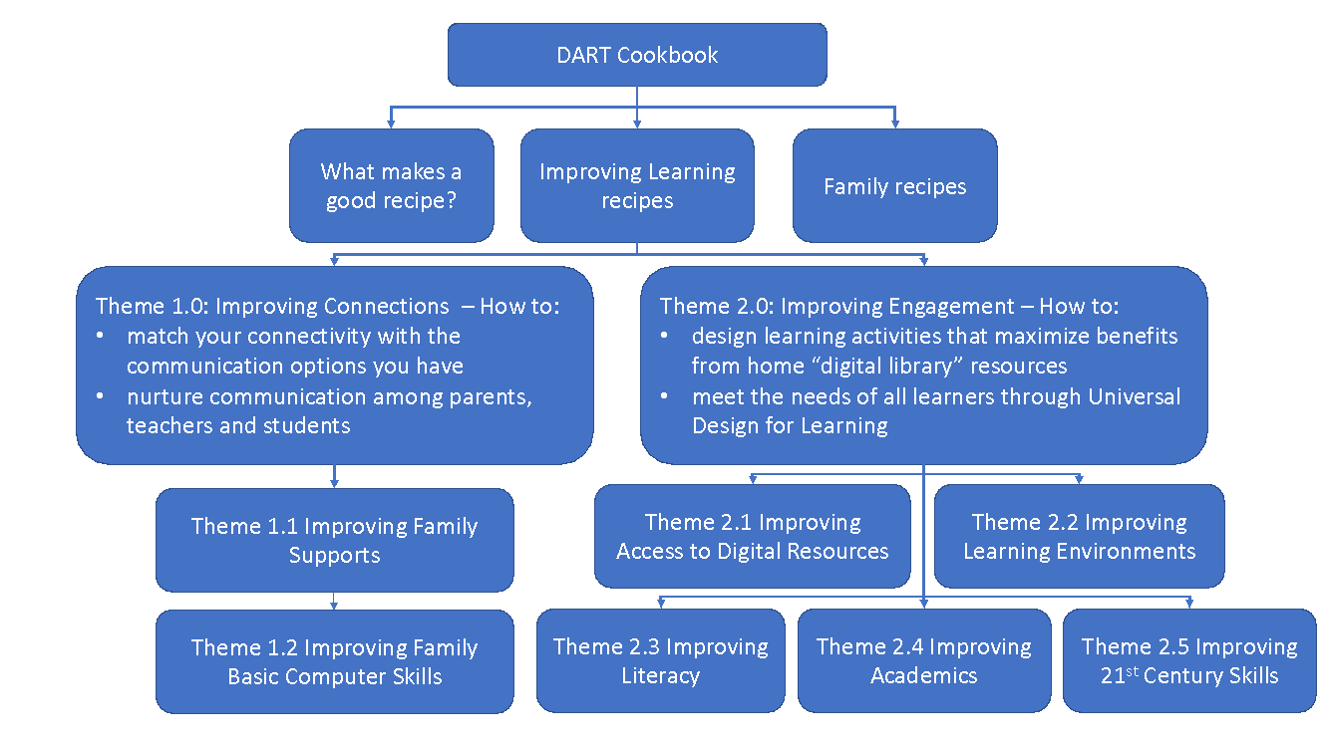
DART Cookbook

Slide 8
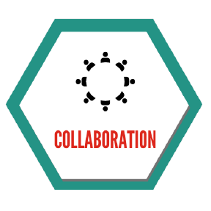
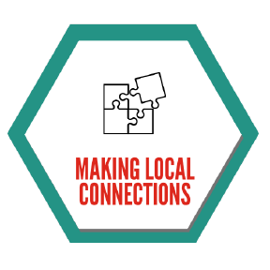
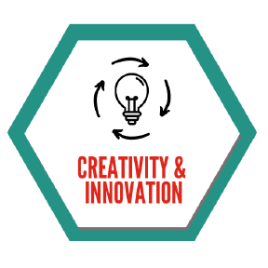
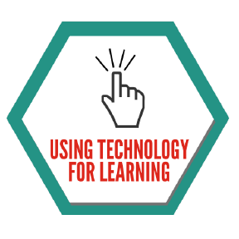
Good Recipes
What makes a good recipe?
It’s accurate and complete
It turns out the way it should when you follow it
People like it enough to ask for the recipe when they’ve tried it
21st Century Skills you use when creating, reviewing and rating recipes

Slide 9
Feedback
Additional themes may be added or dropped
Themes may be combined
Observing feedback from the community provides updated clues for best practices and connected themes

Slide 10
Learning Together Activities
MicroSeasons Activity: https://learn.livingthepotential.com/learning-together/micro-seasons/
21st Century Learning Video: https://learn.livingthepotential.com/21st-century-practices/
https://learn.livingthepotential.com/history-comes-alive-practice/

Slide 11
Learning to Create Together
Which theme do you want to explore further?
Is there an activity that could support your idea?
What clues will you be looking for to get started?
Who do you know - could be interested in working with you?

Slide 12
Next Steps
Take a look around the Learning Together section to explore
an activity that interests you; or another one that you can bring
Which theme interests you?
How might the theme and the activity be connected to your ”recipe”?
Join us on Wednesday for the discussion; and in the meantime please comment in the Community of Practice: New Mexico Project.

