Slide 1
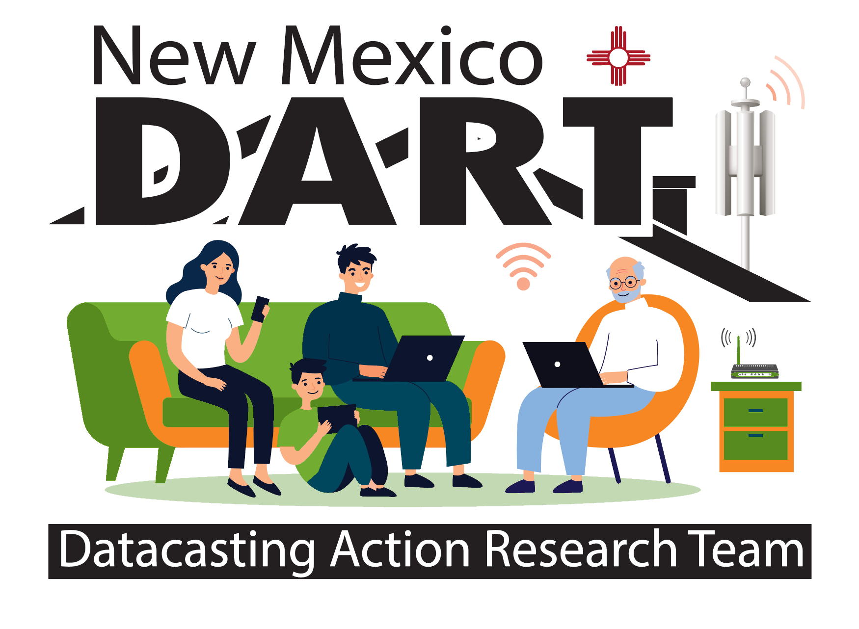
Community of Practice
Lesson 1: Discussion
SCOUT Learning
Notes:
Welcome: We are on a mission! You have been invited to participate in this Pilot Project called DART: Datacasting Action Research Team. Together, we will discover possibilities for solving the problem of lack of connectivity. In cooperation with the New Mexico Public Education Department (NMPED), we are piloting datacasting as a method of improving learning in the home, especially for families whose internet access is not strong enough to support online learning. Under the terms of the Martinez/Yazzie Lawsuit, every family must have a computing device available for learning with a connection that lets learners stream a video, upload/download files and participate in online learning using the systems it provides.
To accomplish these goals, the Datacasting Pilot is seeking parents and teachers to join DART – Datacasting Action Research Teams – who together will produce a final product called the “Datacasting Family Cookbook: Recipes for Improving Learning @ Home”

Slide 2
WHY are WE Here?
What challenge are we trying to solve?
How might we best discover the solutions?
What does learning together look like?
sound like?
feel like?

Slide 3
Possible inquiries for Today
What is D.A.R.T.?
Why are we doing this DART project?
What Is the Community of Practice?
Why do we call ourselves SCOUTS?
How will showing up make a difference?

Slide 4
Scouts Discovering New Territory
Have courage to explore new possibilities
Align efforts for finding new ground
Are eager to uncover the clues along the way
Find satisfaction in contributing their piece
Appreciate the contributions of others on the team
Show up to consistently to grow ideas into next steps
Make a difference because they care to do so
Expect joyful learning along the way

Slide 5
Authentic Connections
Reflections:
What are the first things that comes to mind when you think of life and learning during the Pandemic?
What are two things you would like to improve?

Slide 6
Your Voice Heard Here
Determining whether and how datacasting improves
learning at home for families with limited connectivity.
Notes:
The families who have the receivers will be engaged with their children, along with their teachers and facilitators, to give feedback and ideas for what works and what doesn’t along with new insights that have emerged from learning together with the datacasting receiver and its capacity to deliver communication for learning at home. These ideas, or best practices, will be gathered as recipes for the DART Cookbook, which will support how to best implement the strategies for over 42,000 homes in New Mexico who are currently not being served equitably with technology connectivity.

Slide 7
Design a personal goal for yourself
Based on your idea: what you want to improve?
Your video or written expression: what does success look like?
Make a short video with your expression
Join in on Friday to review learning together in our Community of Practice.

