Slide 1
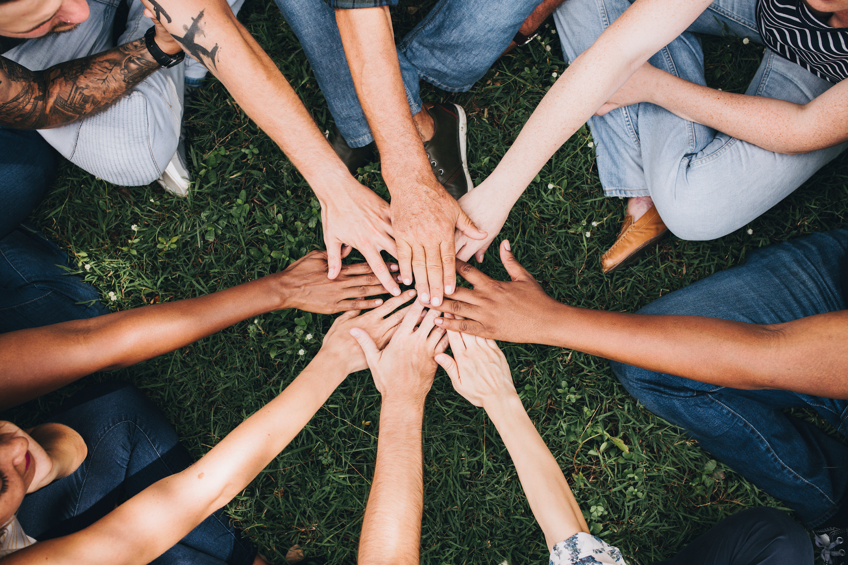
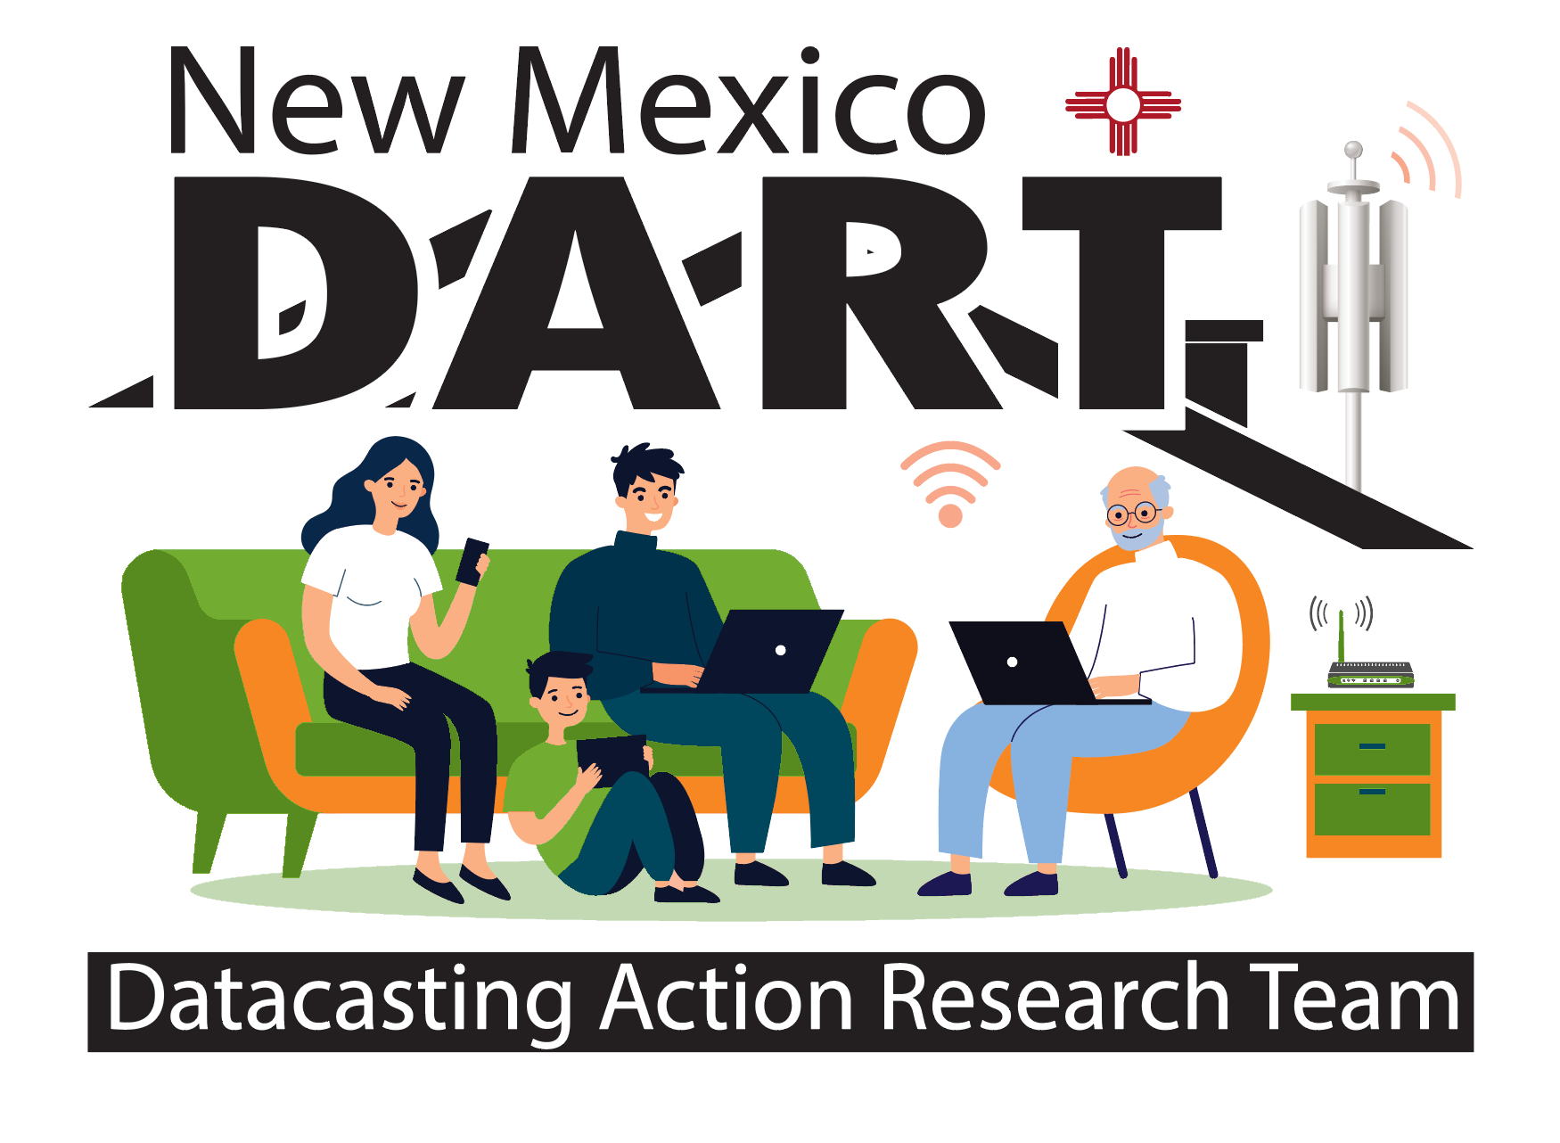
Community of Practice
Lesson1: SCOUT Learning
Notes:
Welcome: We are on a mission! You have been invited to participate in this Pilot Project called DART: Datacasting Action Research Team. Together, we will discover possibilities for solving the problem of lack of connectivity. In cooperation with the New Mexico Public Education Department (NMPED), we are piloting datacasting as a method of improving learning in the home, especially for families whose internet access is not strong enough to support online learning. Under the terms of the Martinez/Yazzie Lawsuit, every family must have a computing device available for learning with a connection that lets learners stream a video, upload/download files and participate in online learning using the systems it provides.
To accomplish these goals, the Datacasting Pilot is seeking parents and teachers to join DART – Datacasting Action Research Teams – who together will produce a final product called the “Datacasting Family Cookbook: Recipes for Improving Learning @ Home”

Slide 2
Our Mission: Connectivity on Two Levels
Level 1 | Technology A key issue the teams will be addressing is the “return path,” which is a critical factor in determining whether datacasting solution will improve:
1. Connecting students, teachers and parents/caretakers
2. Asking questions
3. Giving feedback
4. Submitting work
Notes:
Description of the Pilot Project:
Five districts are participating to discover the best possible pathways for achieving digital equity for their families, so learning can happen at home with technology adaptations. 100 families in each district will get data casting receivers in their homes, to be used together with hotspots the district has provided. The receivers will be able download content from Google Classroom or Canvas which will support the students to do homework or further study what had been covered in their classes.
The receivers will also have bilingual literacy software that will provide opportunities for the family to learn together. The research will also address how improved connectivity impacts social emotional learning in ways that improve engagement when families have what they need to learn from home. Integrating the 21st Century thinking skills as a framework will reveal how the teams work together to accomplish the desired outcomes and objectives. These skills include: communication, collaboration, critical thinking skills and innovation, self-directed learning, local and global connections, as well as learning with technology.
There are teams of people from each district that will include: students, parents, teachers, and IT support who will be participating to give feedback on how the datacasting is working and what needs to be improved. A team of students from Worcester Polytechnic Institute (WPI) will be part of the research team as they complete their own academic capstone by working to improve digital connectivity in New Mexico The college sends junior engineering students to New Mexico each fall. Last year’s team worked on digital equity projects with the Public Education Department, leading to this fall’s Digital Sovereignty Project. Specifically, the students will measure connectivity in student homes and evaluate strategies to improve learning at home. Several students from the Super Computing Challenge will also be collaborating with this project in ways that will support the implementation moving forward after the pilot project.
A key issue the teams will be addressing is the “return path,” which is a critical factor in determining whether the solutions will improve:
1. learning opportunities for these students and replace opinions with empirical facts
2. which (teaching) methods best support which types of learning activities
3. learning gains seen for students and families with broadband, without broadband but using datacasting, or who don’t access online learning resources from home

Slide 3
Our Mission: Connectivity on Two Levels
Level 2 | Community
We want a community in which all stakeholders (students, parents, grandparents, caretakers, teachers, guides, facilitators, and administrators) are co-creators of knowledge that leads all to take wise action, so:
How do we best engage the wisdom of indigenous communities as essential for the new pathways for meaningful connection with technology?
How do we best engage our youth learners to be seen and heard in meaningful connection with technology?
How will parents/grandparents/caretakers be engaged in supporting learning at home?
How will this project support school learning engagement?

Slide 4
Connectivity and Meaningful Learning
Discover how learning happens at home with technology
Experience a natural approach to family learning based on curiosity and discovery
Observe how the “homework” gap can be bridged- so students are not left behind and teachers and parents witness engagement

Slide 5
Authentic Connections
Reflections:
What are the first things that comes to mind when you think of life and learning during the Pandemic?
What are two things you would like to improve?

Slide 6
The Scout Learning Flow
On Monday: a new connectivity lesson is introduced
On Tuesday: a video for deepening the learning on the topic
Wednesday: Live Discussion-what are we discovering so far
Friday: Review what is working; sharing ideas for improvement

Slide 7
Learning in Community
Discover learning with others who care about the same things you do
Empowering relationships enhance learning for everyone
Each person’s contribution is necessary and equal to solving the Digital Divide issue
Learning to design a community “recipe book” will make a big difference to over 42,000 families

Slide 8
Your Voice Heard Here
Determining whether and how datacasting improves
learning at home for families with limited connectivity.
Notes:
The families who have the receivers will be engaged with their children, along with their teachers and facilitators, to give feedback and ideas for what works and what doesn’t along with new insights that have emerged from learning together with the datacasting receiver and its capacity to deliver communication for learning at home. These ideas, or best practices, will be gathered as recipes for the DART Cookbook, which will support how to best implement the strategies for over 42,000 homes in New Mexico who are currently not being served equitably with technology connectivity.

Slide 9
Our Contributions Make a Difference
Discovering the red zones will help drive next steps for improvement
Observing the yellow zones and what causes the inconsistencies?
Tracking the green zones and how learning at home creates success patterns for students and members of their family
Together we are solving the problems associated with lack of digital equity.

Slide 10
Scouts Discovering New Territory
Have courage to explore new possibilities
Align efforts for finding new ground
Are eager to uncover the clues along the way
Find satisfaction in contributing their piece
Appreciate the contributions of others on the team
Show up to consistently to grow ideas into next steps
Make a difference because they care to do so
Expect joyful learning along the way

Slide 11
Participate and Make a Difference
Add your ideas-you will be recognized for your contributions
Work-based content could be compensated-this is worth your time
Like and comment on other people’s contributions
Look for clues and patterns-let’s discuss in the forum what you discover

Slide 12
Activity
Watch the Orientation Video ( if you haven’t already done so) Click Here https://www.dropbox.com/s/uqgalmfi64u9n8t/Final%20Welcome%20CoP%20video1521908453.mp4?dl=0
Record your learning
Use: Flip Grid- as a tool for personal expression Click Here https://www.loom.com/share/cf147148d8e8492a9886ce1ff47bd10d for instructions.
And/or write your reflections down in a journal

Slide 13
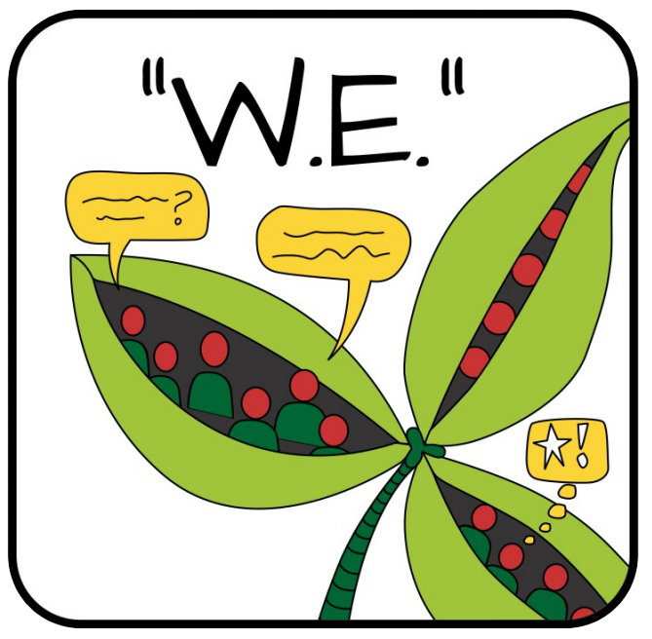
Next: Designing Pods
Help create a “pod” : could include a parent, teacher, mentor, a grandparent, and other students
“No two minds ever come together without, thereby, creating a third, invisible, intangible force which may be likened to a third mind.”
~ Napoleon Hill ~
Wisdom Engagement: good ideas come in all sizes

